Slide 1

ZeroMQ investigation
Author: Hua Van Thong
Group: DJ10

Slide 2
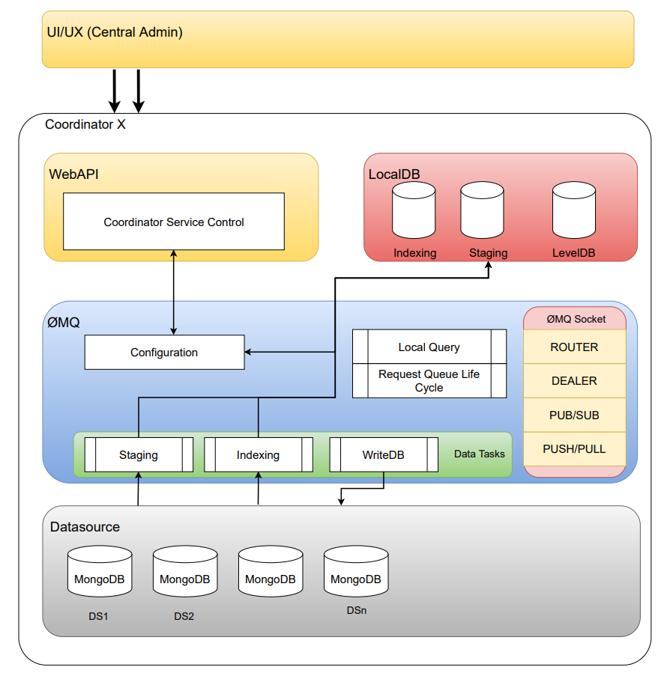
Introduction
This documents will introduce about ZeroMQ library in MongoDB Fabic project.
This will focus on the Socket component

Slide 3
Table of content
1. What is ZeroMQ?
2. Socket Types
3. Message Patterns
Request Reply Pattern
Multiple Request Socket/ json over ZeroMQ
Exclusive Pair Pattern
Push Pull Pattern
Publish Subscribe Pattern
Dealer Router Patter
4. Multiple sockets.
Handle multiple sockets by polling

Slide 4
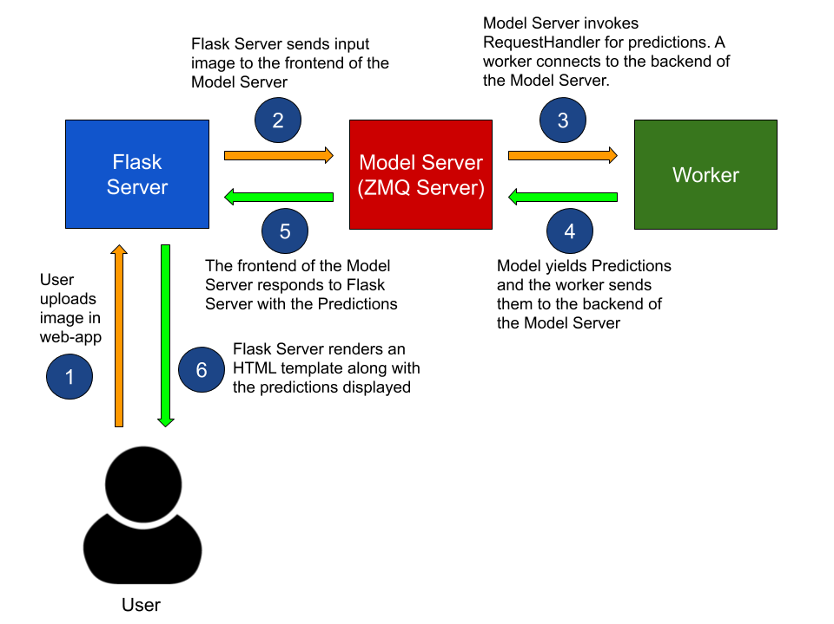
1. What is ZeroMq?
ZeroMQ is not demo, is not Server. ZeroMQ is a library.
ZeroMQ is a way to connect things together.
We can use ZeroMQ to talk each other with:
Two different machines on a network
Two different processes on one machine.
Two different thread within one process.

Slide 5
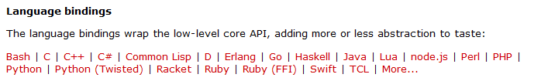
1. What is ZeroMq?
Message library ( 20 languages)
5 Message pattern
Synchronous Request/Response
Asynchronous Request/Response
Publish/Subscribe
Push/Pull
Exclusive Pair
Brokerless (meh)

Slide 6
2. What is Socket Types?
Sockets is the way to allow communicate each other.
ZeroMQ provides socket to communicate in the particular way.
REQ
REP
PUSH
PULL
DEALER
ROUTER
Thereby, we can combine them together to create message pattern

Slide 7
3. What is message pattern?
Messaging patterns are network oriented architectural pattern that describes the flow of communication between interconnecting systems.
ZeroMQ provides pre-optimized sockets which enables you to take advantage of these patterns.

Slide 8
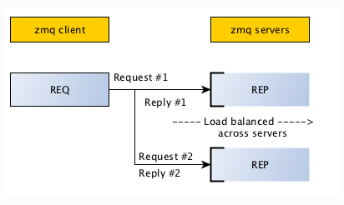
Request reply pattern
Most basic pattern is client/server model, where client sends a request and server replies to the request.
Refer: https://learning-0mq-with-pyzmq.readthedocs.io/en/latest/pyzmq/patterns/client_server.html

Slide 9
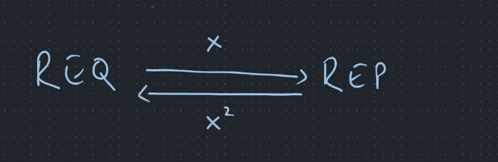
Example 1
We getting started with a example below.
Implement a socket type REQ, send message x to socket type REP, and receive message x^2.

Slide 10
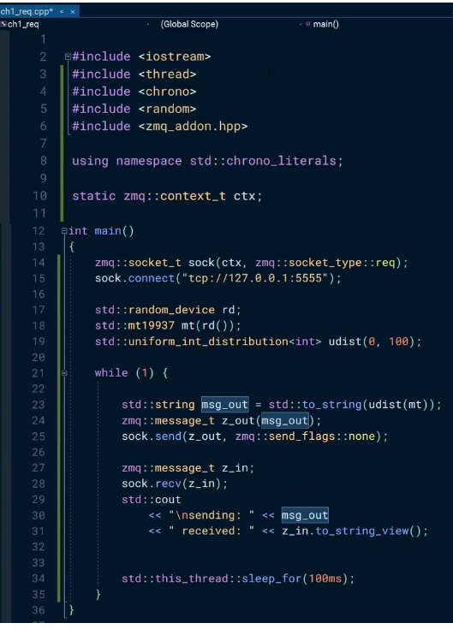
Example 1
On request side
S1: Create a socket type req, and connect to port
S2: Connect to port 5555
S3: Create a message and put to zmq.
S4: Use socket to send message out
S5: Receive message from reply
S1
S2
S3
S4
S5

Slide 11
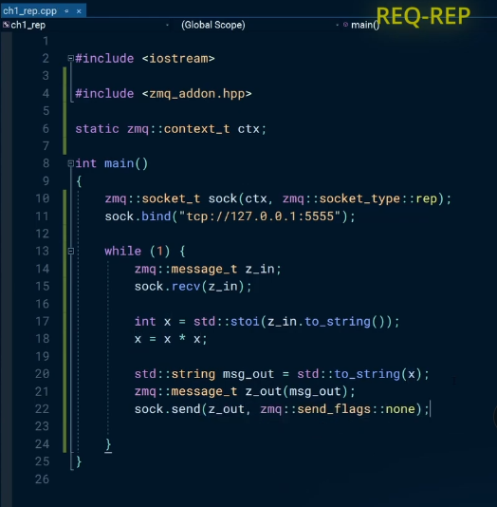
Example 1
On reply side
S1: Create a socket type rep
S2: Connect to port 5555
S3: Receive message from req
S4: Process data
S5: Send message to req
S1
S2
S3
S4
S5

Slide 12
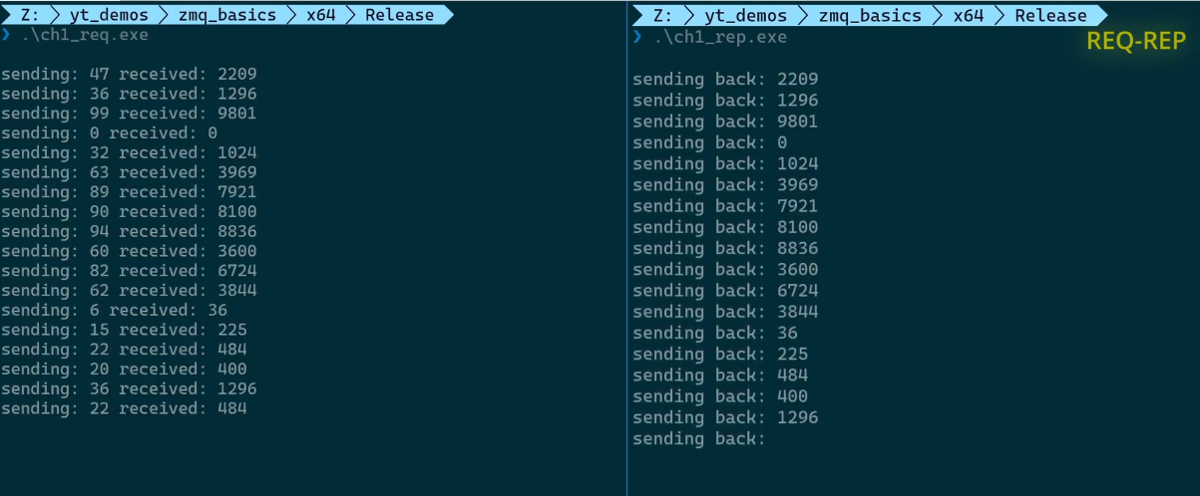
Example 1
Output console

Slide 13
Request reply pattern
Base on request-reply pattern, we can expanse to many different cases.
For a example:
We can create multiple request to server.
We can send json message instead of string message.
….
Read more at reference.

Slide 14
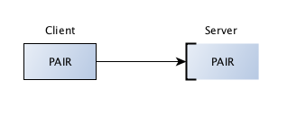
Exclusive pair pattern
Paired sockets are very similar to regular sockets.
The communication is bidirectional.
There is no specific state stored within the socket
There can only be one connected peer.
The server listens on a certain port and a client connects to it.
Refer: https://learning-0mq-with-pyzmq.readthedocs.io/en/latest/pyzmq/patterns/pair.html

Slide 15
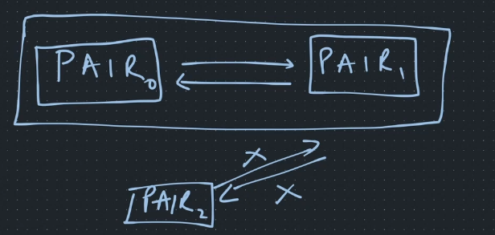
Example 2
We getting started with a example below.
Implement a socket pair0 communicate to socket pair1
Create another socket pair2, try to connect to pair1

Slide 16
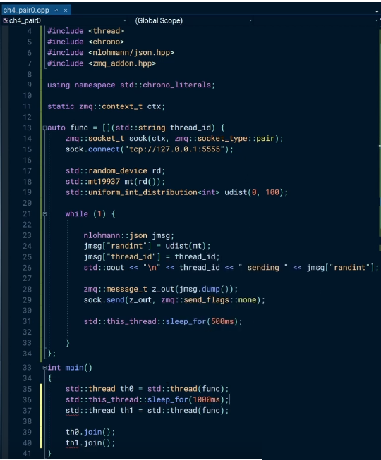
Example 2
On client side
S1: Create a socket type pair for client side.
S2: Connect to port 5555.
S3: Create a json message, and dump json info to zmq following thread id
S4: Use socket to send message out to server
S5: Create pair0 by thread0, create pair1 by thread1.
S1
S2
S3
S4
S5

Slide 17
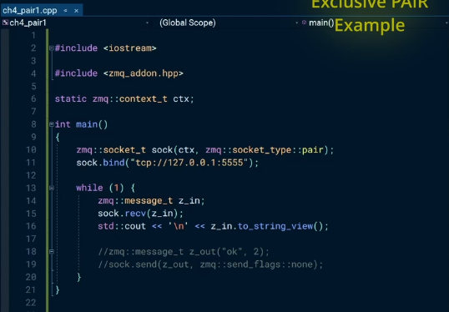
Example 2
On server side
S1: Create a socket type pair for server side.
S2: Connect to port 5555.
S3: Receive message from client.
S4: Dump message out.
S1
S2
S3
S4

Slide 18
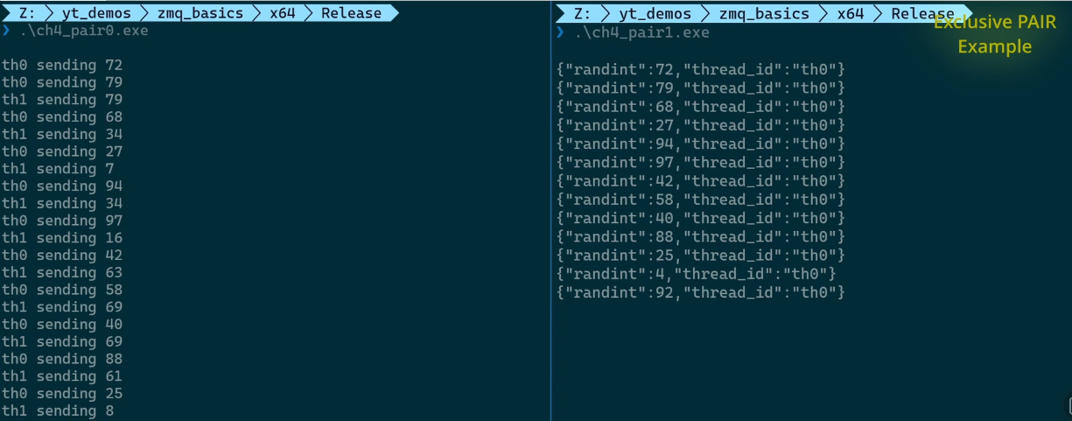
Example 2
Output console

Slide 19
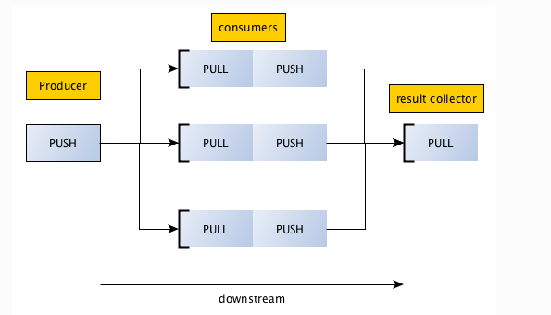
Push pull pattern
Push and Pull sockets let you distribute messages to multiple workers, arranged in a pipeline.
A Push socket will distribute sent messages to its Pull clients evenly.
This is equivalent to producer/consumer model but the results computed by consumer are not sent upstream but downstream to another pull/consumer socket.
Refer: https://learning-0mq-with-pyzmq.readthedocs.io/en/latest/pyzmq/patterns/pair.html

Slide 20
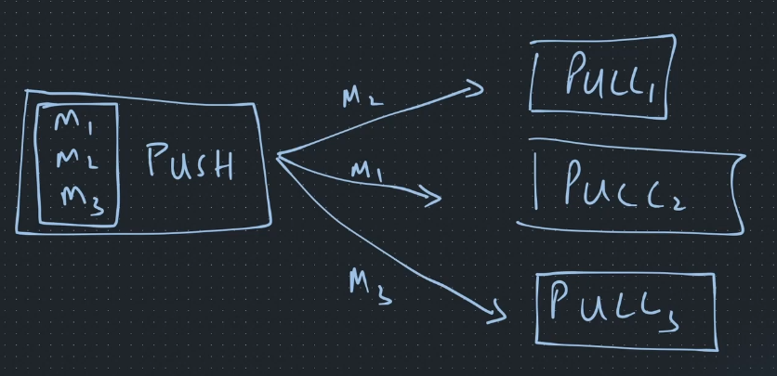
Example 3
We getting started with a example below.
Implement a socket push, and push all message to each socket pull

Slide 21
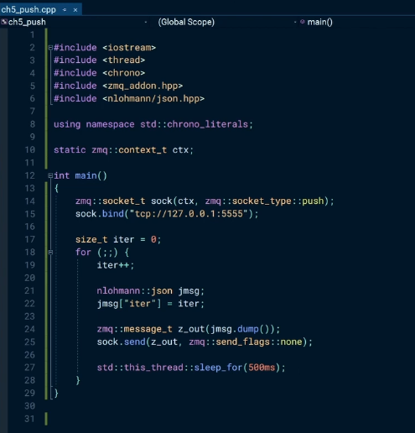
Example 3
On push side
S1: Create a socket type push.
S2: Connect to port 5555.
S3: for loop to create message
S4: Send message to socket pull.
S1
S2
S3
S4

Slide 22
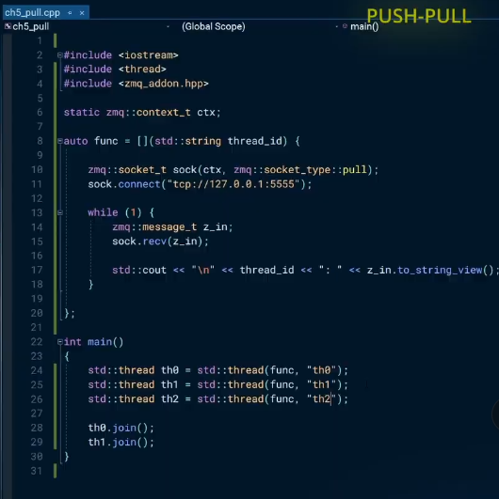
Example 3
On pull side
S1: Create a socket type pull.
S2: Connect to port 5555.
S3: Receive message from socket push.
S4: Dump message to console
S5: Create multiple socket pull by thread.
S1
S2
S3
S4
S5

Slide 23
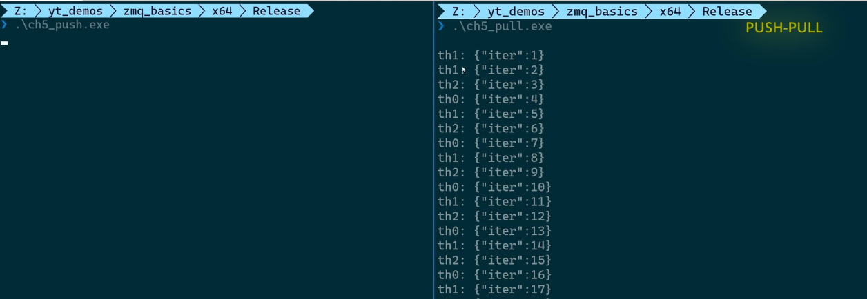
Example 3
Output console

Slide 24
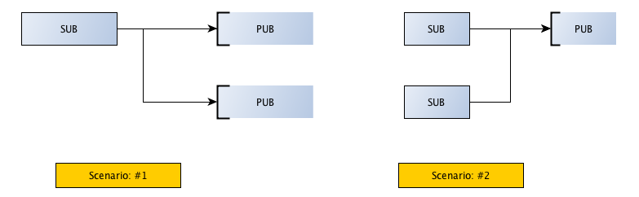
Publish Subscribe Pattern
Publish/Subscribe is another classic pattern where senders of messages, called publishers.
The messages to be sent directly to specific receivers, called subscribers
Messages are published without the knowledge of what or if any subscriber of that knowledge exists.
Refer: https://learning-0mq-with-pyzmq.readthedocs.io/en/latest/pyzmq/patterns/pubsub.html

Slide 25
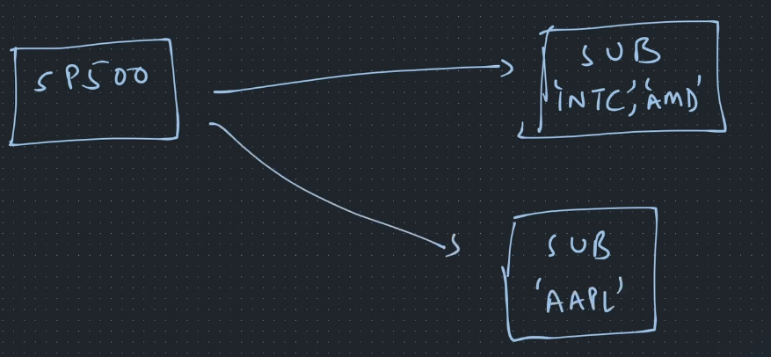
Example 4
We getting started with a example below.
Implement a socket publish, and two socket subscriber.
Publish will send message to 3 kind of message, and SUB1 will receive message “INTC”, “AMD”, SUB2 will receive message “AAPL”

Slide 26
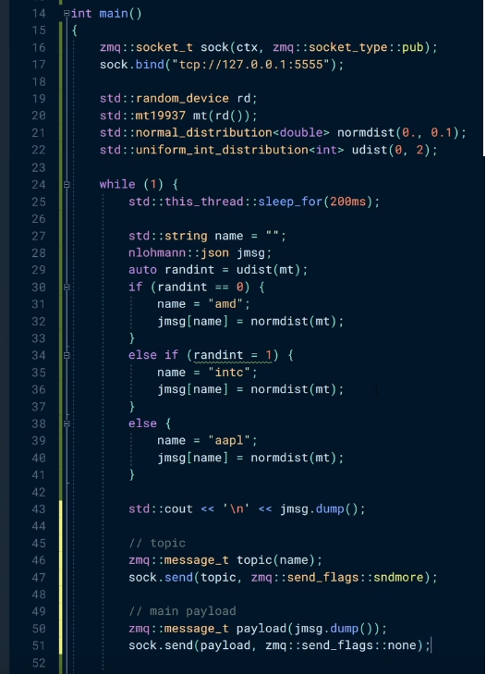
Example 4
S1
S2
On publish side
S1: Create a socket type pub.
S2: Connect to port 5555.
S3: At here, we will select a type message following our expectation
randint = 0 => create message “amd”
randint = 1 => create message “intc”
Other => create message “aapl”
S4: Send message to Subcribers
S3
=>
=>
=>
S4

Slide 27
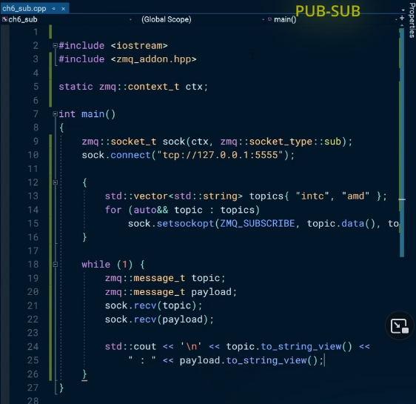
Example 4
On subscriber side
S1: Create a socket type sub.
S2: Connect to port 5555.
S3: Create topics to subscribe.
S4: Register that topic to socket Subscriber
S5: Use multipart to receive message from Publisher.
S1
S2
S3
S4
S5

Slide 28
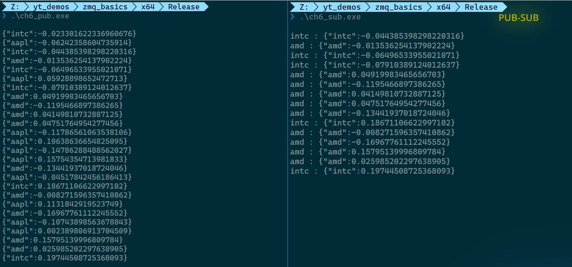
Example 4
Output console

Slide 29
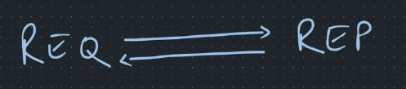
Dealer router pattern
Why we need dealer router pattern?
As we know about REQ/REP pattern, there are some disadvantage below:
REP can only reply to the socket that sent the msg.
It means that we have one client that talks to one service
REQ: must do send + rcv
REP: must do recv + send
However, in our case, we need multiple services as well as multiple clients.
Refer: http://u.delta9.pl/k/ReadThis/%C3%98MQ%20-%20The%20Guide%20-%20%C3%98MQ%20-%20The%20Guide.html

Slide 30
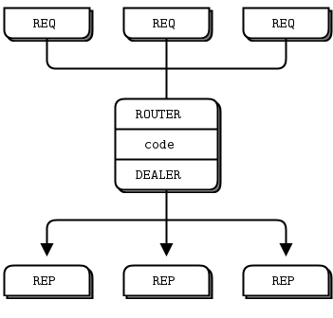
Dealer router pattern
Advantage:
RTR tracks identities .
RTR & DTR sockets do not have to follow the
send + recv cycle
DLR sockets can recv & send messages.
You can connect DLRs with DLR, RTR with RTRs
& DLR with RTRs

Slide 31
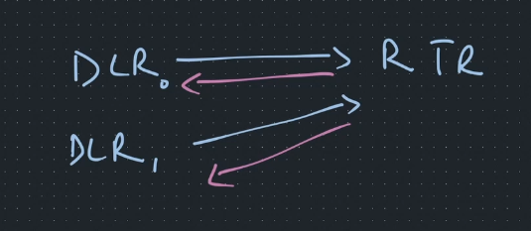
Example 5
We getting started with a example below.
We will implement socket Dealer0 and Dealer1 to send message RTR.
Router will only select one Dealer0, and allow message pass away.

Slide 32
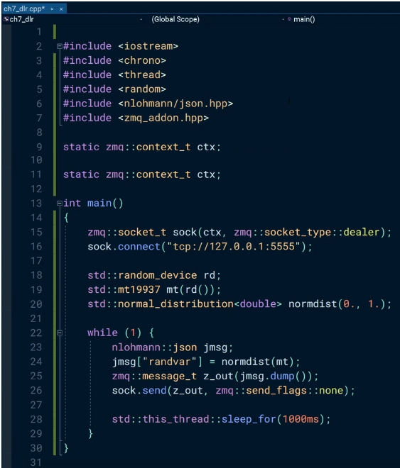
Example 5
On dealer side
S1: Create a socket type dealer.
S2: Connect to port 5555.
S3: while(1) to always create message to router.
S4: send message to router.
S1
S2
S3
S4

Slide 33
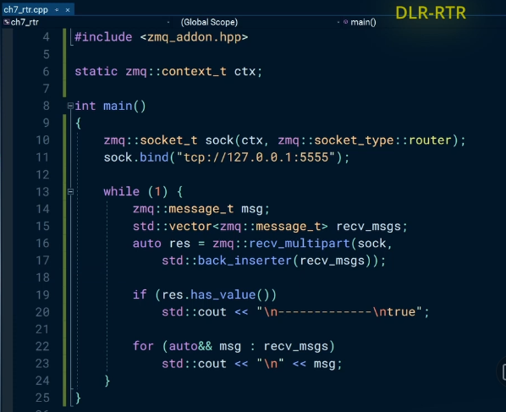
Example 5
On router side
S1: Create a socket type router.
S2: Connect to port 5555.
S3: Receive message from socket dealer.
S4: if res has value inside.
S5: Dump message to console.
S1
S2
S3
S4
S5

Slide 34
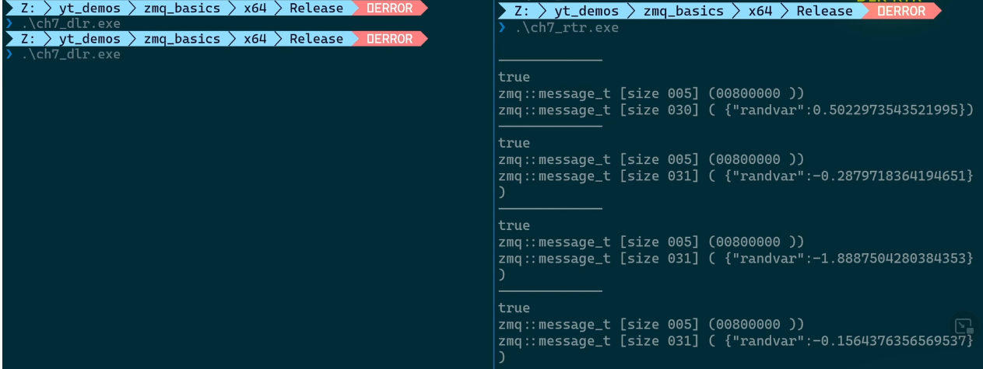
Example 5
Output console

Slide 35
4. Multiple sockets
Using multiprocessing module helped us to launch the server, clients as processes from the same program.
However, you would have noticed that this still suffered from one limitation. These processes would serve only one socket connection.
However, in real world a process might be connected to multiple sockets and work on data received on both.
How you do handle in this case?
Refer: Polling and Sockets — Learning 0MQ with examples (learning-0mq-with-pyzmq.readthedocs.io)

Slide 36
Handle multiple sockets by poll
Solution
In this situation, it is better to poll for data on the sockets.
And in ZMQ, it provides facility for polling sockets as you can not block on recv().

Slide 37
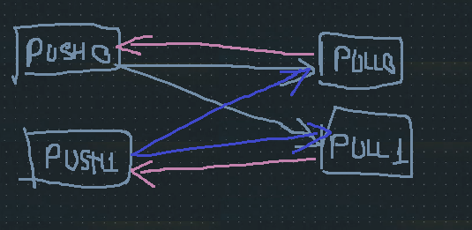
Example 6
We getting started with a example below.
We will implement two PUSH socket to send all message to 2 socket PULL.
Socket PULL0 reply message to PUSH0
Socket PULL1 reply message to PUSH1

Slide 38
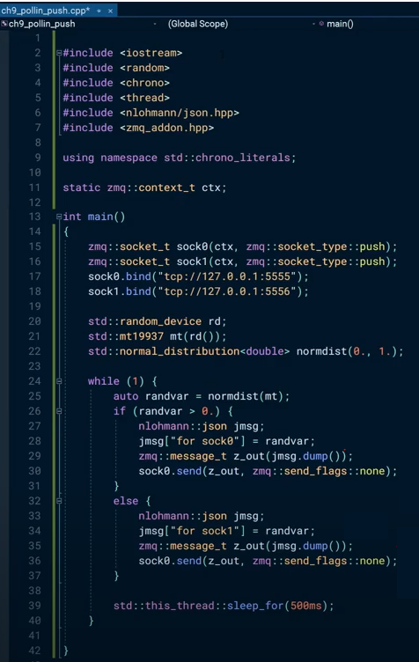
Example 6
On dealer side
S1: Create a socket as push type connect to port 5555
S2: Create a socket as push type connect to port 5556
S3: Send message to socket pull0
S4: Send message to socket pull1
S1
S2
S1
S2
S3
S4

Slide 39
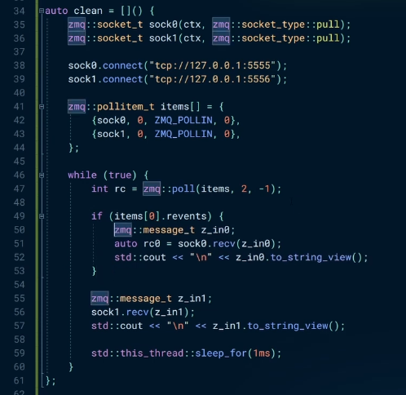
Example 6
On router side
S1: Create a socket as pull type connect to port 5555.
S2: Create a socket as pull type connect to port 5556.
S3: Create a storage to store all pollin item to recognize socket push.
S4: Poll in all items.
S5: If item 0 is valid, reply message to socket push0.
S6: Other, reply message to socket push1
S1
S2
S3
S4
S5
S6

Slide 40
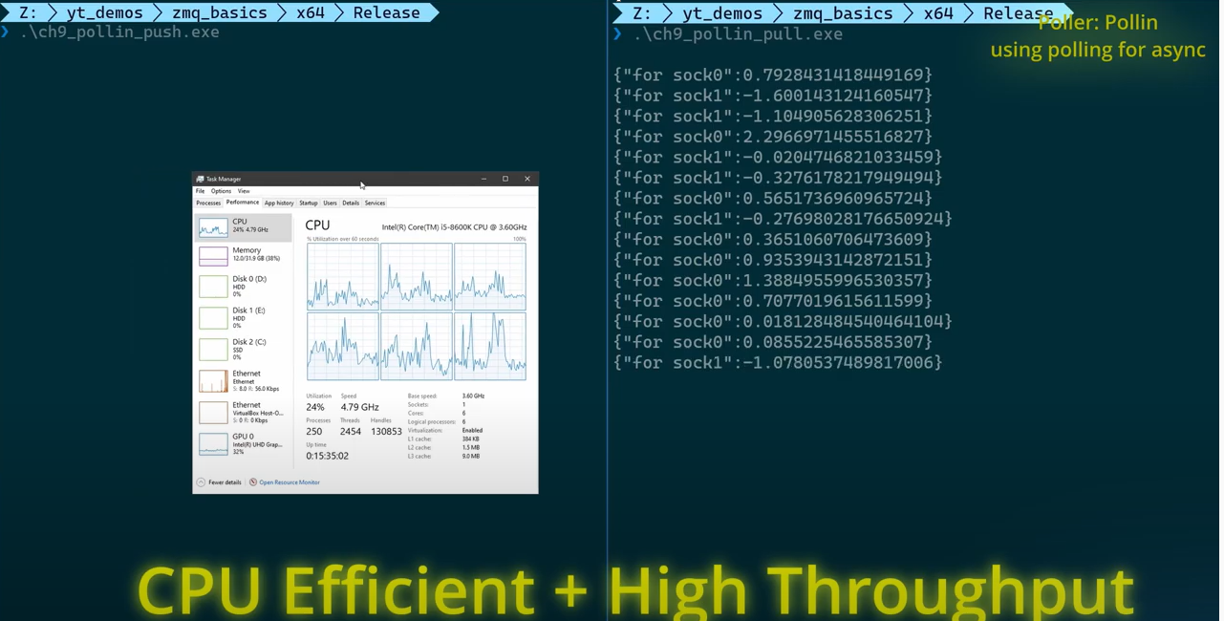
Example 6
Output console

Slide 41
Summary
ZeroMQ have a way to handle multiple socket by using poll() method.
Using poll() help us get some benefits:
Improve performance on CPU.
Get high throughput.
In addition to using poll in, we also can use poll out at push side.

Slide 42
Reference
To read more about Zeromq:
https://zguide.zeromq.org/docs/chapter1/
To read more examples in C++ project:
https://www.youtube.com/watch?v=T_4uAmlawbI&t=1239s

